Slide 1
DATA MINING AS A CONFLUENCE OF MULTIPLE DISCIPLINES
TEAM MEMBERS :
SAI VIKRAM ALLADI
KARTHIK GOUD BALUSA
ANWITHA REDDY BOMMANA
SAI DIVYA PASUPULETI

Slide 2
INTRODUCTION
The phrase data mining as a confluence from multiple disciplines means that data mining is field that integrates and merges different disciplines.
Data mining is nothing but extracting the knowledge /information from different data sources.
Data mining extracts this knowledge using techniques , algorithms and methodologies from multiple domains which can be considered as disciplines.

Slide 3
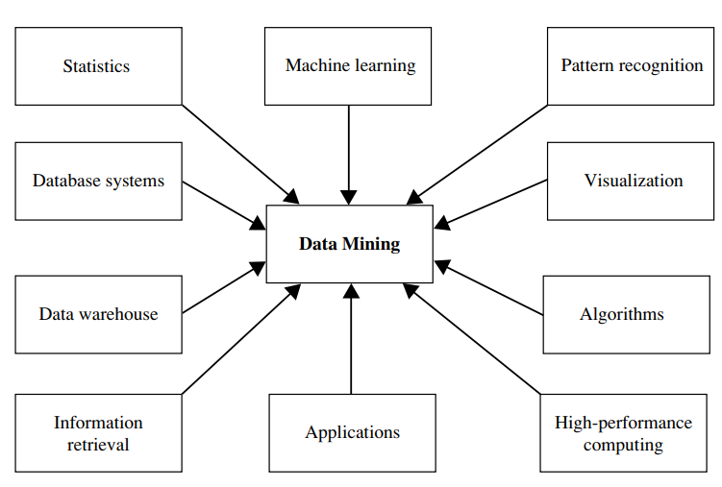
Different Domains

Slide 4
Statistics
There is a fundamental connection between mining and statistics.
Statistics and data mining both use mathematical notions to get the task done.
Statistical models like data characterization ,classification and many can be the out comes of data mining.
Statistical methods can also be used to verify data mining results.
Data mining algorithms when combined with statistical approaches should be efficient to handle a large amount of data ,should handle distributed data, should be able to decrease computational cost,and should also accept continues incoming of data (example:online applications)
Example: Statistical and data mining models to group customers based on their purchasing behavior, address , and preferences.

Slide 5
Machine Learning
Data mining often uses machine learning algorithms to automate the detection of patterns and make predictions or classifications based on training data.
Machine learning can reduce the manual effort in such a way that the models use the mining algorithms and automate in producing business decisions.
Example: Demand forecasting , can help in forecasting and predicting the demand of the sales, which can help the business in production of required supply and can avoid dead stock.

Slide 6
Database Systems and Data Warehouses
To mine the data or extract the knowledge we need data and that can be obtained from data bases or data warehouses/repositories.
A data base system or data warehouse combines with the data mining techniques can result in a huge amount of potential knowledge.
Database systems are often well known for their high scalability in processing very large, relatively structured data sets.
The data mining tasks need to handle the large data sets in realtime .
Data mining can make good use of scalable database technologies to achieve high efficiency and scalability on large data sets
Example: Retail Store Analysis, Supply Chain Optimization of Business

Slide 7
Information Retrieval
IR techniques , retrieve relevant content based on user queries or specific keywords.
When a user searches for a particular topic or brand, the system retrieves related posts, comments, and reviews from its database.
But how can a person receive the data which is related to search, like there may be many results out of which only some may be relevant to the search.
Data mining techniques are applied to the results of information retrieval and the best out comes are presented to the user , which results in user satisfaction.
Eg: A person searches something on web, the results are retrieved from the database , sentiment analysis is applied to the results and the best potential results are demonstrated to the user.

Slide 8
Visualization
After the knowledge is extracted from the data set used data mining , it should be valued or helpful for the clients or business.
It is very important that the knowledge extracted by the data , should be in an understanding format for the end users , that where data mining requires visualization.
Visualization helps the patterns mined to get into a easy format, like charts, plots and etc by which a non technical person can understand the knowledge extracted and can take useful decisions.
Visualization makes the decision making easy.

